Slide 1
A quick and practical comparison: phylogenetics vs phylogenomics, vs pangenomics
http://merenlab.org/momics

Slide 4
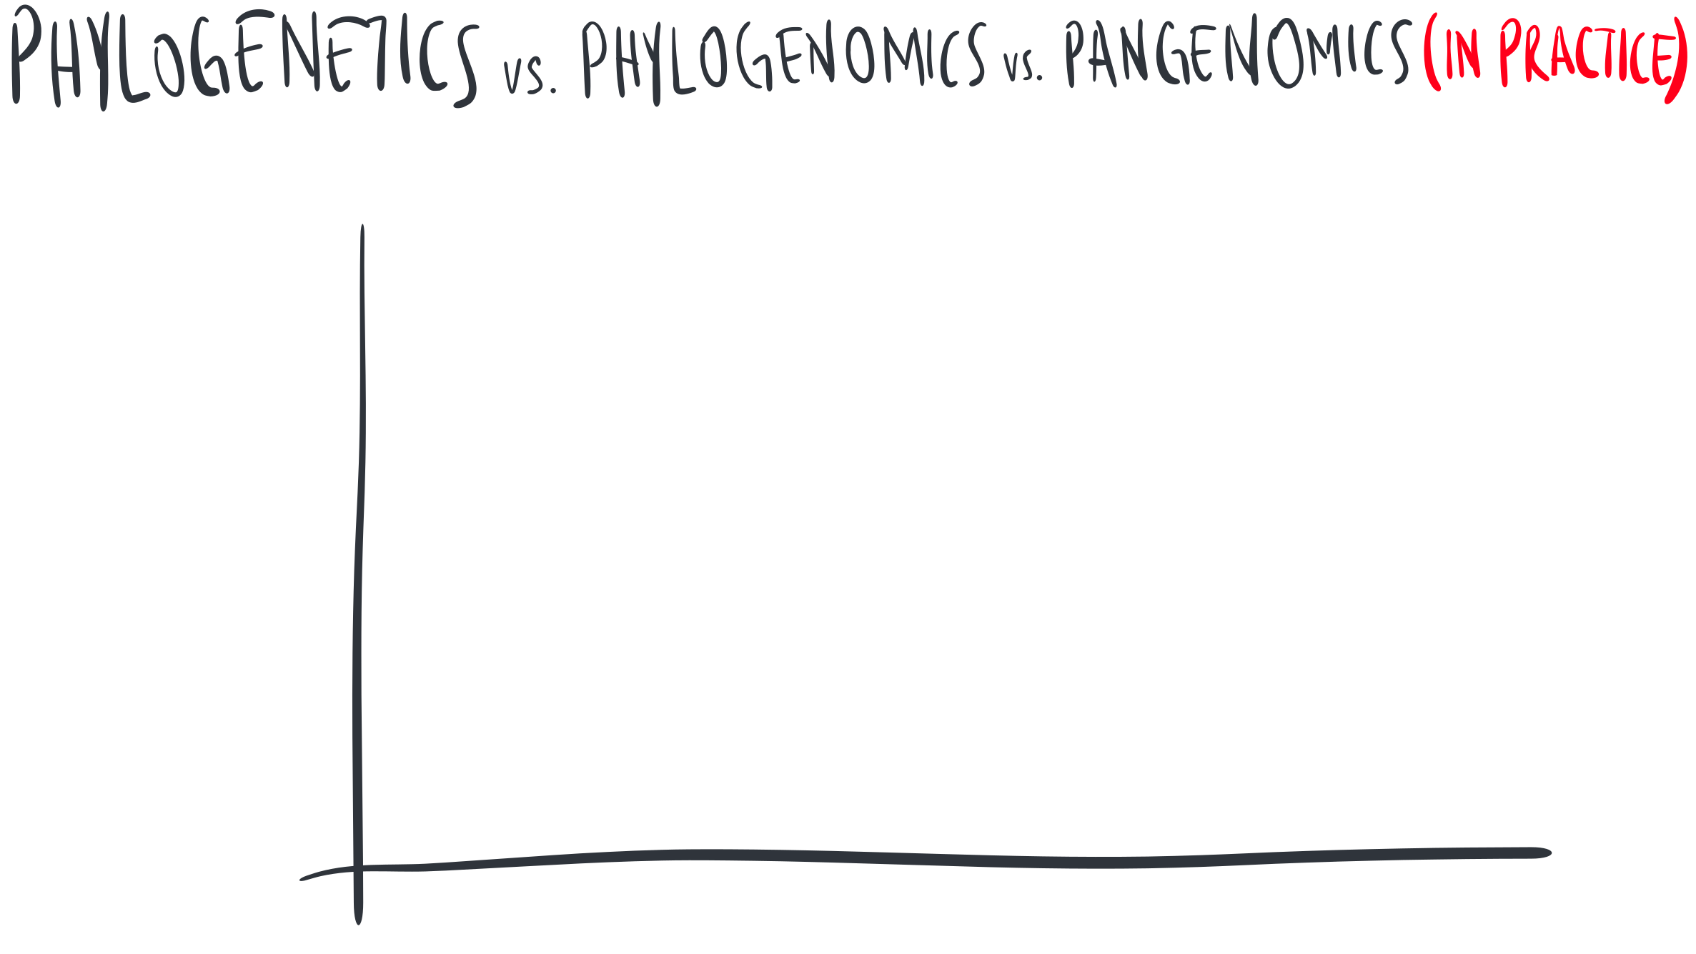

Slide 5
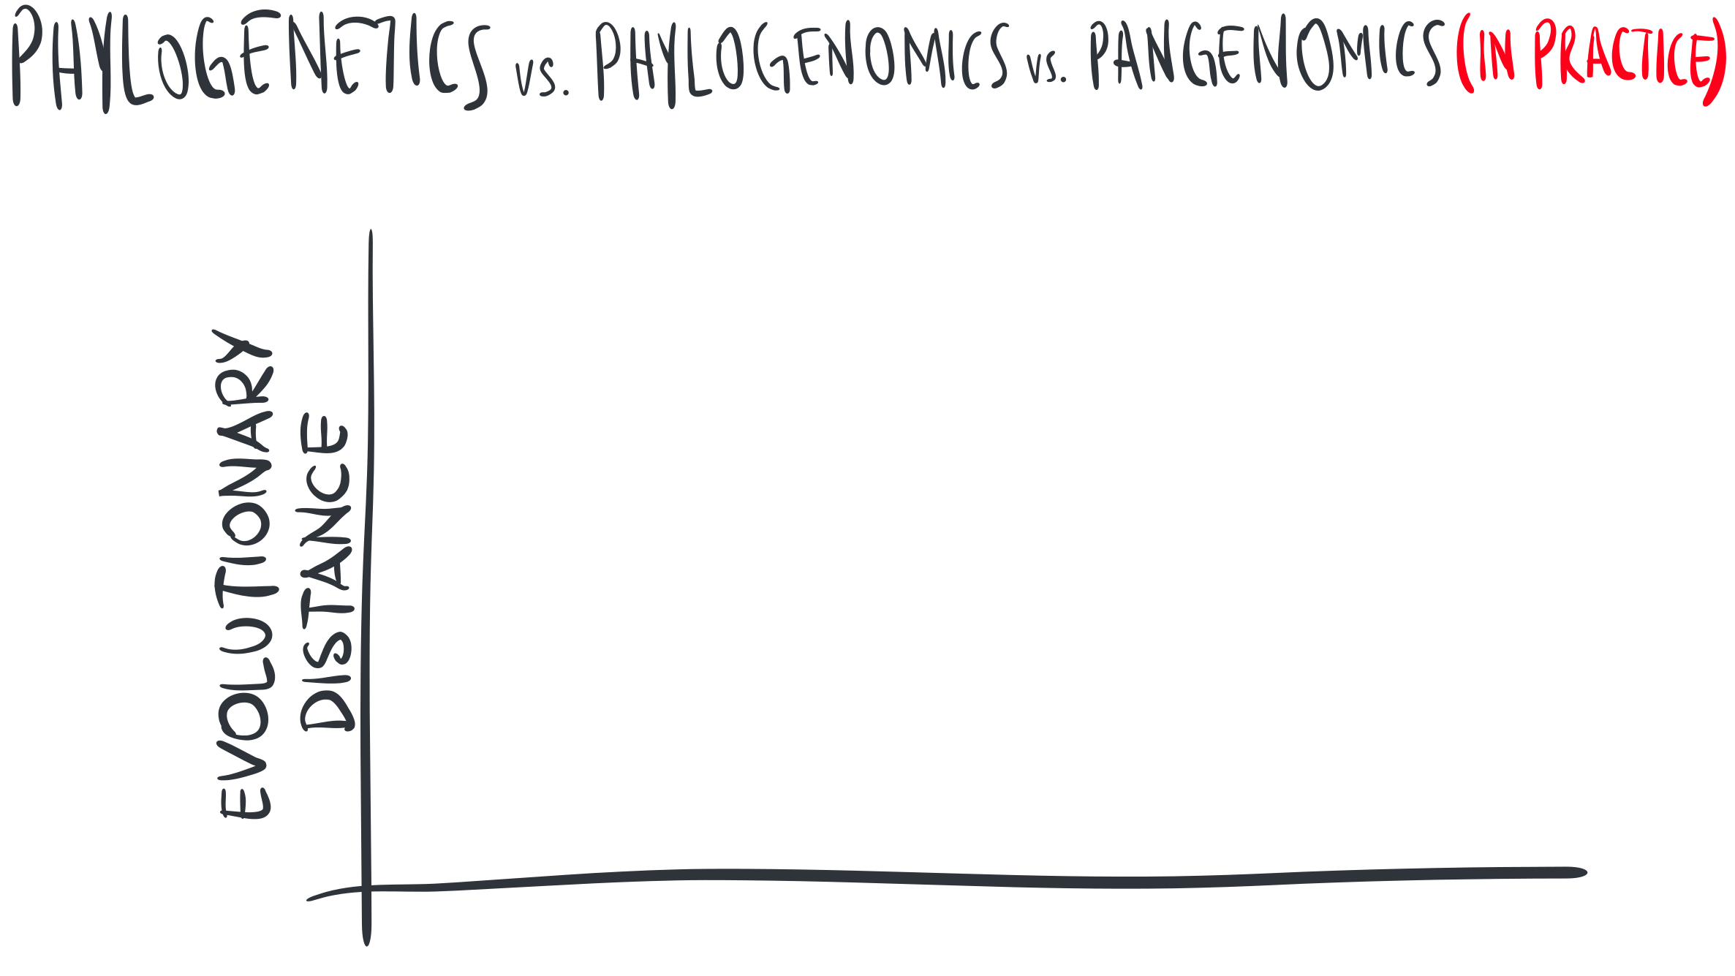

Slide 20
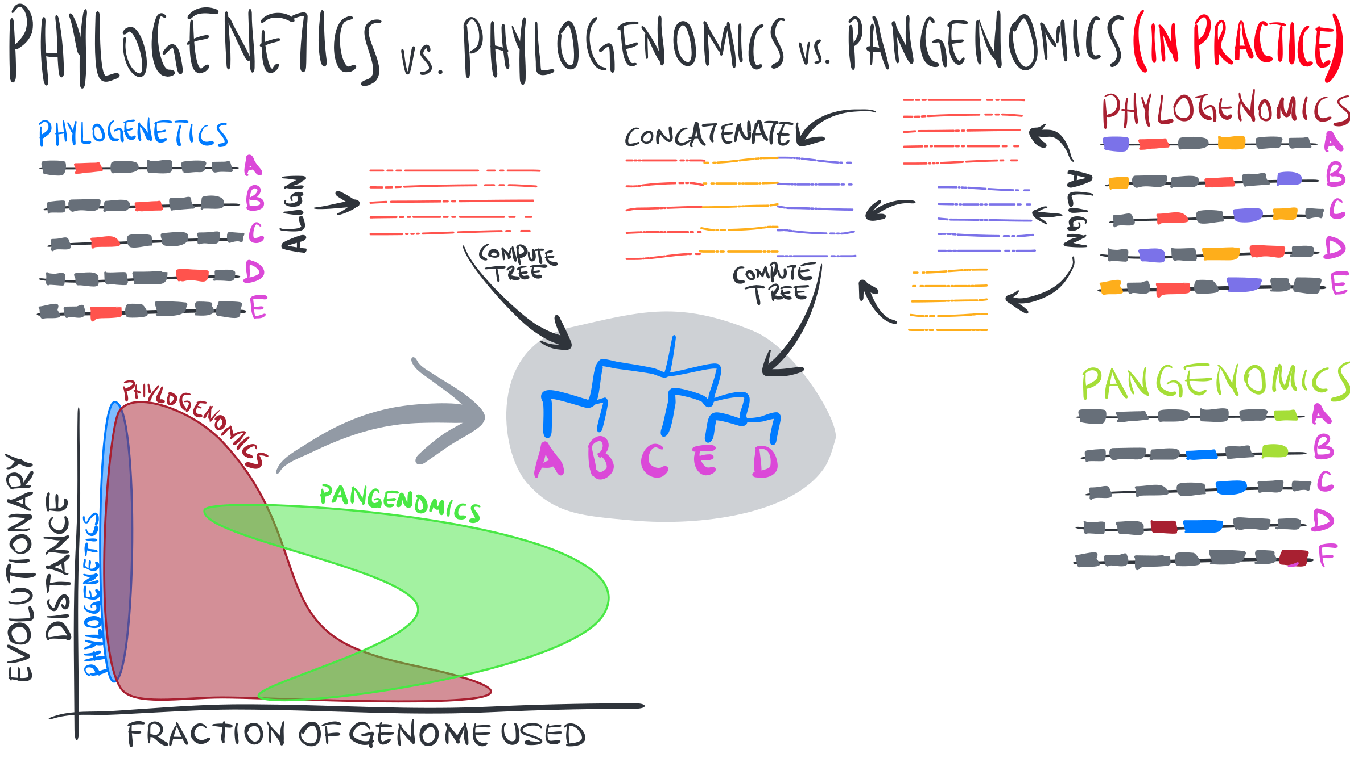

Slide 21
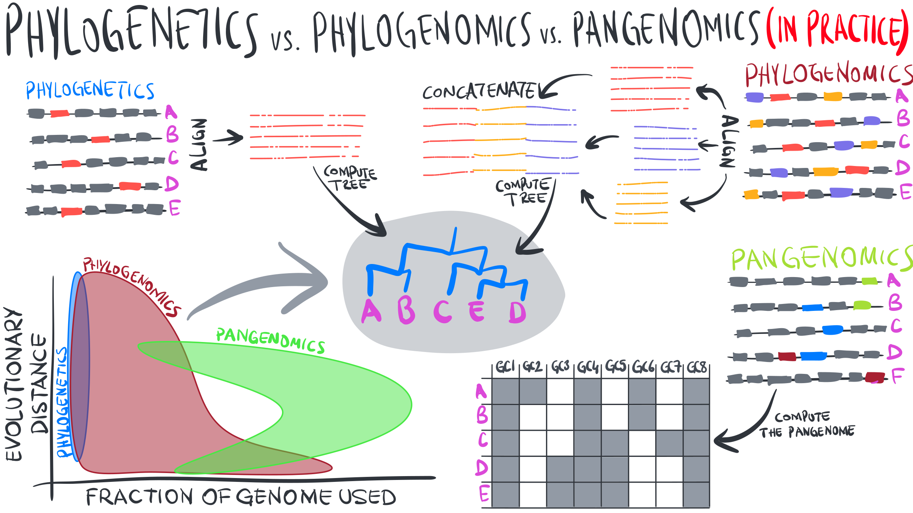

Slide 22
