Slide 1
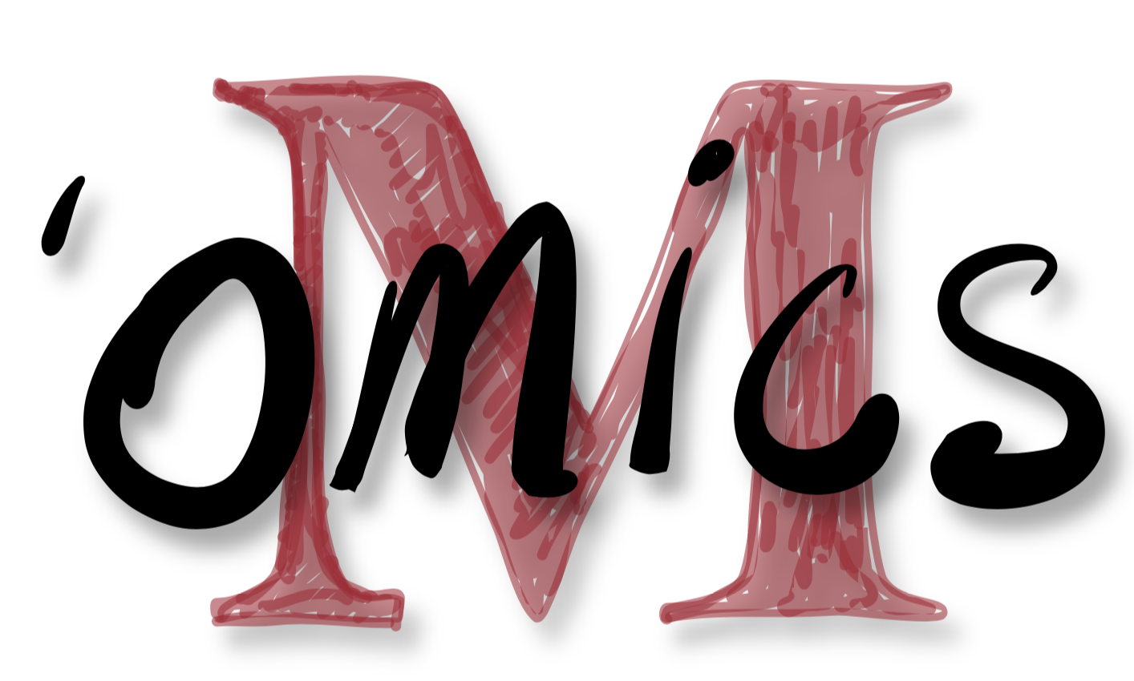
The power of metagenomic read recruitment
http://merenlab.org/momics

Slide 2
The power of metagenomic read recruitment
to see the ‘obvious’
http://merenlab.org/momics

Slide 3
Notes:
Metagenomic read recruitment is at the core of most things we will discuss, and most things you will do when you do your own ‘omics analyses.
It is the strategy of aligning short reads in a metagenome to a reference context. This context could be an entire genome or a single contig.

Slide 4
Notes:
Let’s say we have a reference context like this,

Slide 5
Notes:
And a metagenome from an environment.

Slide 6
Notes:
Metagenomic read recruitment will find all the reads that match to different parts of this genome. And we can display them like this to see where they match.
Q: what do you think that blank area mean?

Slide 7
Notes:
Does this help?
So that area means that the reference genome we are using to recruit reads contains two genes that are not occurring in the naturally occurring population in this environment even though it is similar.
Q: So what’s up with that highly covered section?

Slide 8
Notes:
Let’s assome we have to more metagenomes from two more environments.

Slide 9
Notes:
And let’s keep in mind where those genes are so it is easier to follow.

Slide 10
Notes:
Here is environment #2.
Q: How would you interpret this?

Slide 11
Notes:
Here is the environment #3.
Q: How would you interpret this one?
Indeed, these short reads can tell us something about the nature of these populations in these environments regarding their occurrence and abundance.
Abundance is often is correlated with ‘coverage’.

Slide 12
Notes:
Coverage is a statistic that tells us the average number of short reads matching to each nucleotide position in a reference sequence.
Q: What is the coverage of this genome in the second environment? Make a guess.

Slide 13
Notes:
How about the third one?

Slide 14
Notes:
Hmm. The average coverage of this genome is identical in these two environments. But is this an accurate representation of the ecology of these environments in the context of this genome?
Clearly coverage can be misleading.
Q: What else could we do to have a more balanced understanding?

Slide 15
Notes:
Detection is a statistic that tells us about the fraction of nucleotides in the reference sequence that are covered by at least at 1X.

Slide 17
Notes:
Aha. Much better.

Slide 18
The power of metagenomic read recruitment
to see the ‘subtle’
http://merenlab.org/momics

Slide 19
Notes:
Aha. Much better.

Slide 20
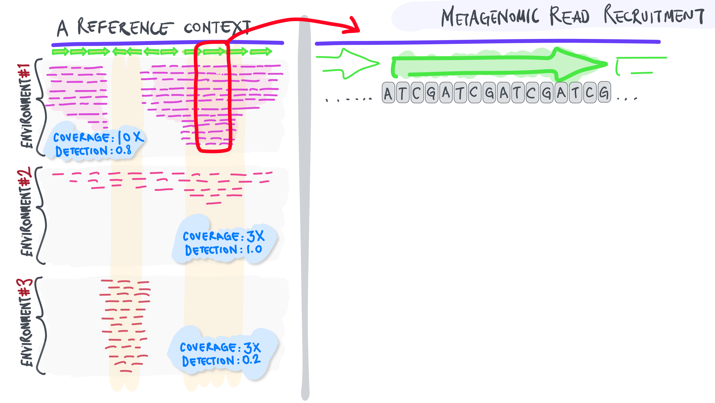
Notes:
Let’s say we zoom in to this part

Slide 21
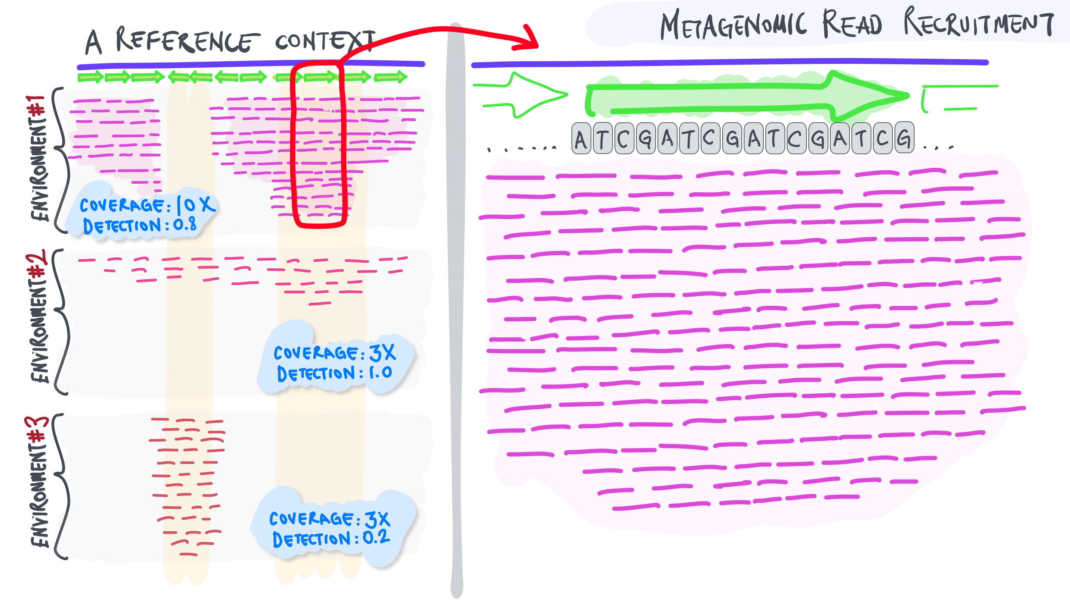
Notes:
And take a much more careful look at the reads recruited.
Q: Do you expect every single read to be identical to the reference context?
It rarely occurs in fact. But sometimes due to reasons that are not related to biology…

Slide 22
Notes:
For instance if there is a single read in this mapping results where there at that particular location you see an A instead of a T.
Q: What would you think?
This could be due to a sequencing error, right?

Slide 23
Notes:
How about now?

Slide 24
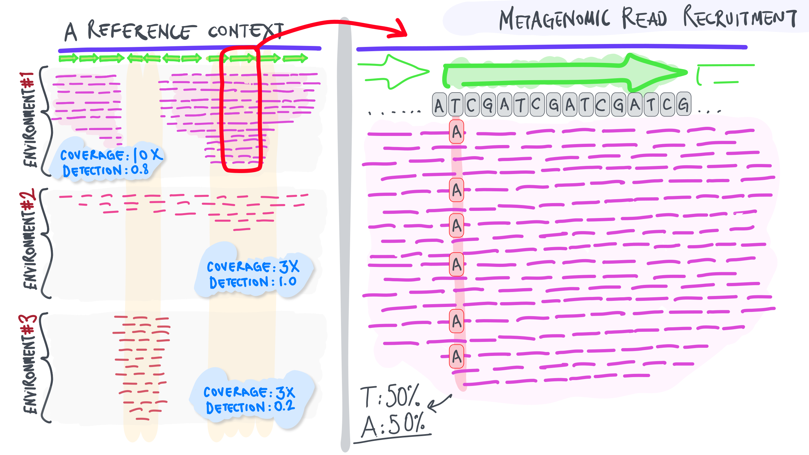
Notes:
What would this statistic tell you?

Slide 25
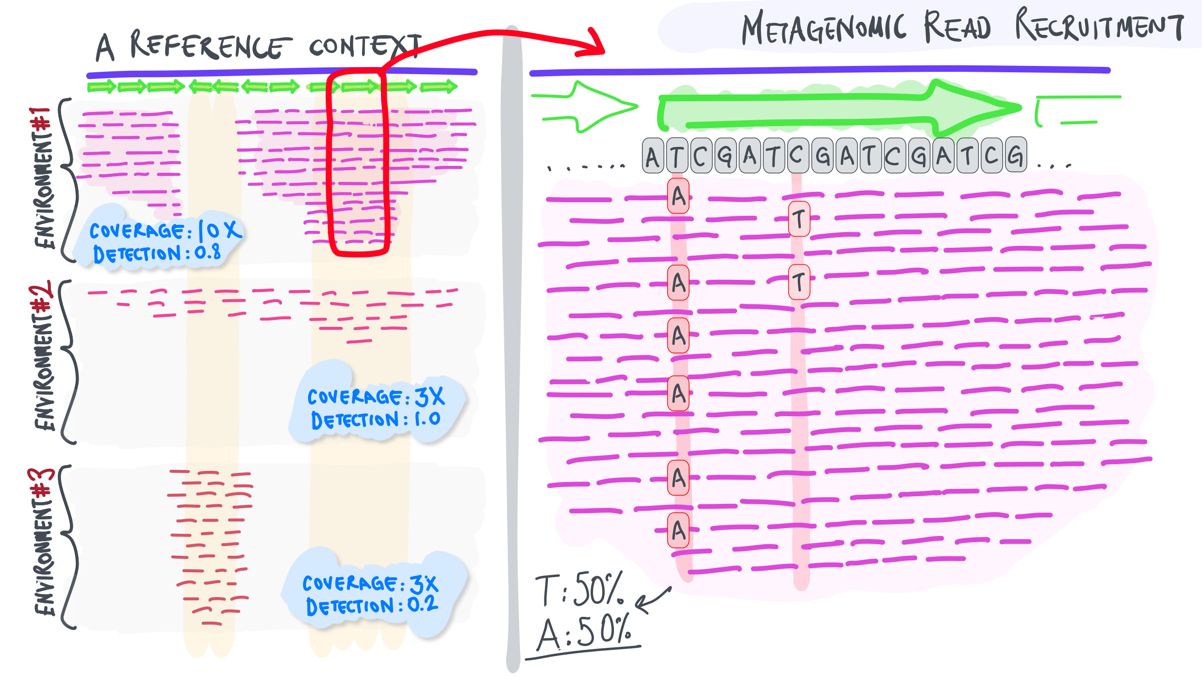
Notes:
Next you see this.

Slide 26
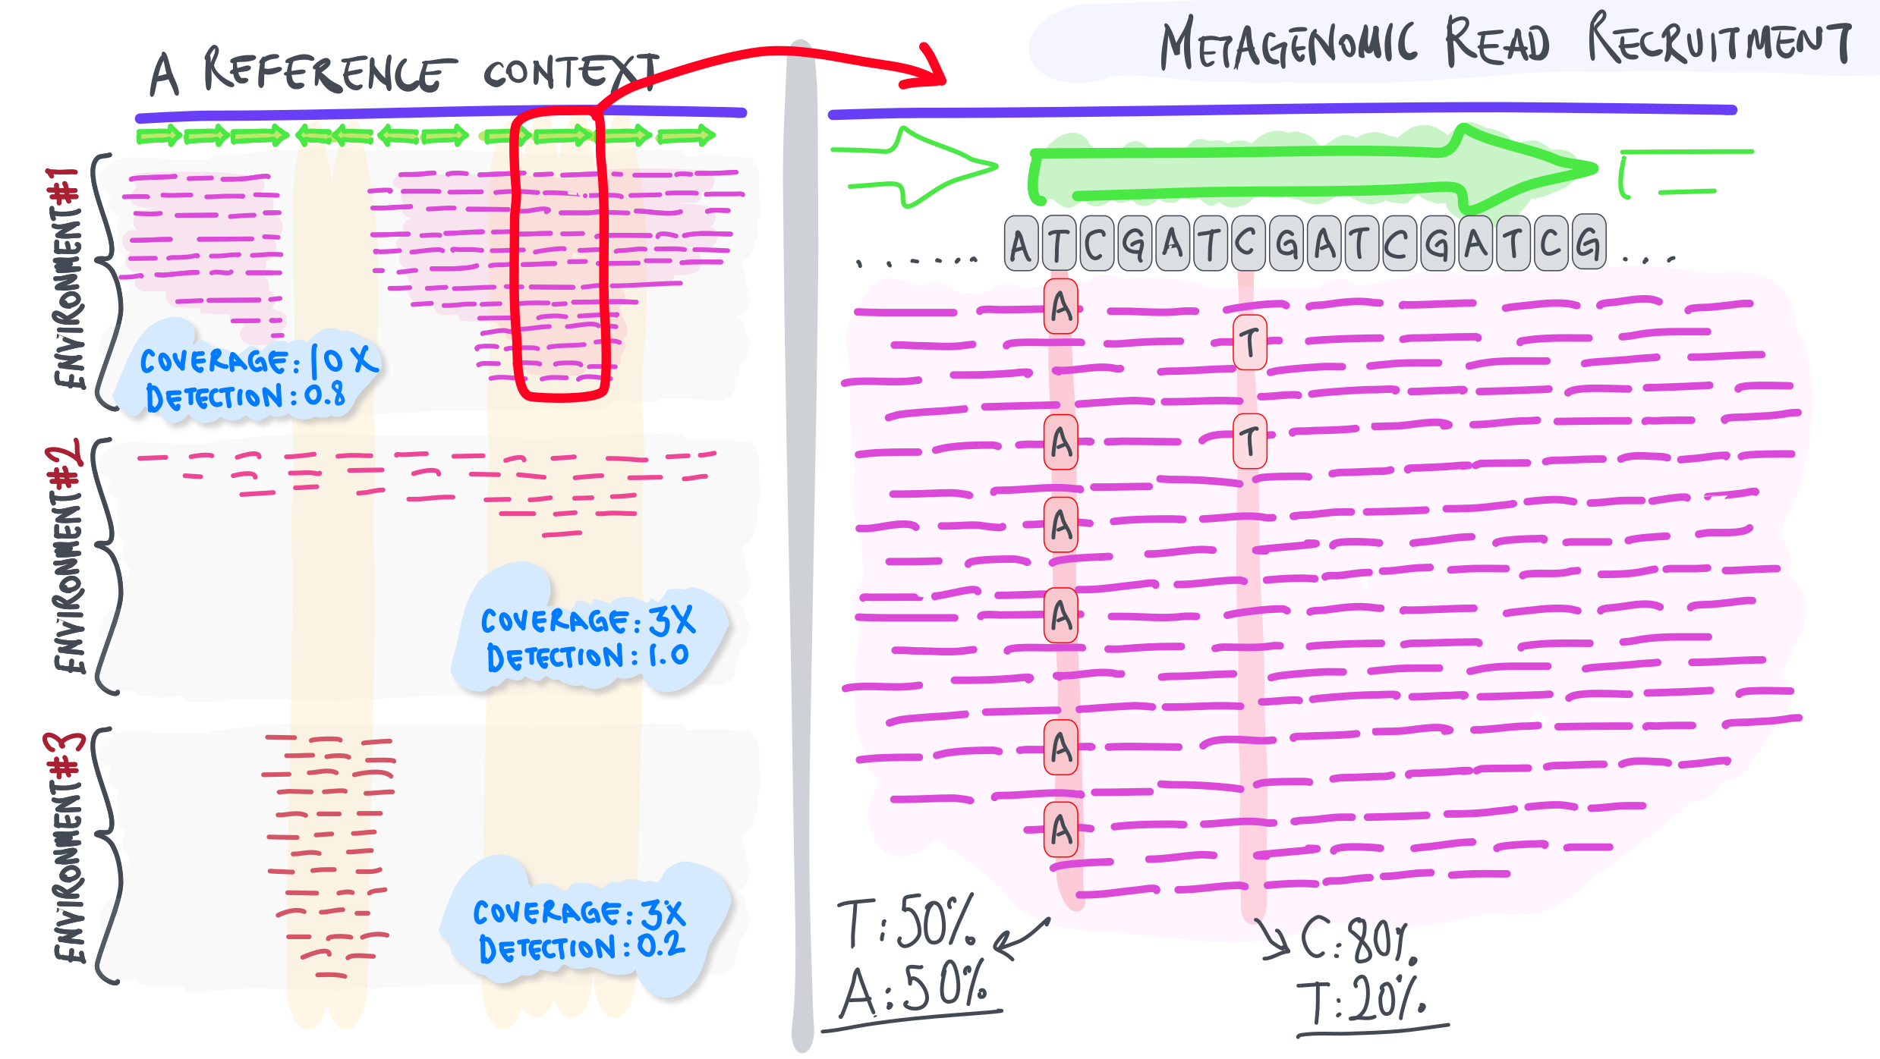
Notes:
How about now? What can we tell about the complexity of this environment?

Slide 27
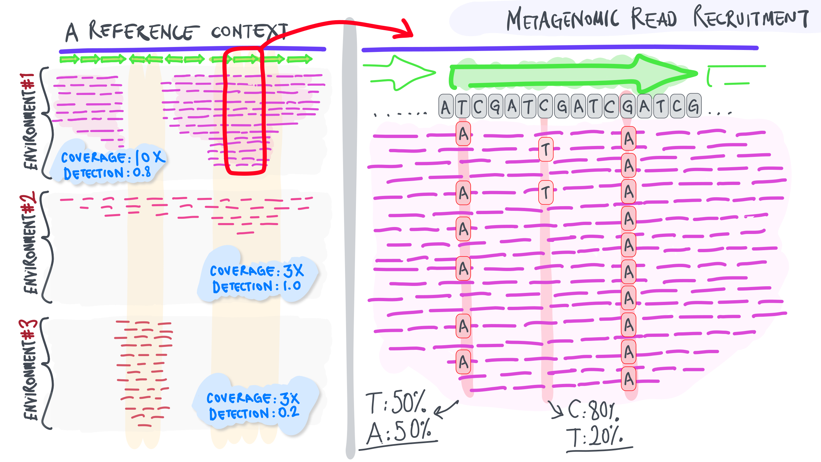
Notes:
Then let’s say we see this.

Slide 28
Notes:
What would this mean?
As you can see, there is so much we can learn about single-nucleotide variants. Temporal and spatial variation in SNVs can offer insights into evolutionary pressures acting upon environmental populations. We will talk much more about this in later weeks.
Let’s go back to where we were now.
Q: Where were we before we jumped into this side track?

